Slide 1
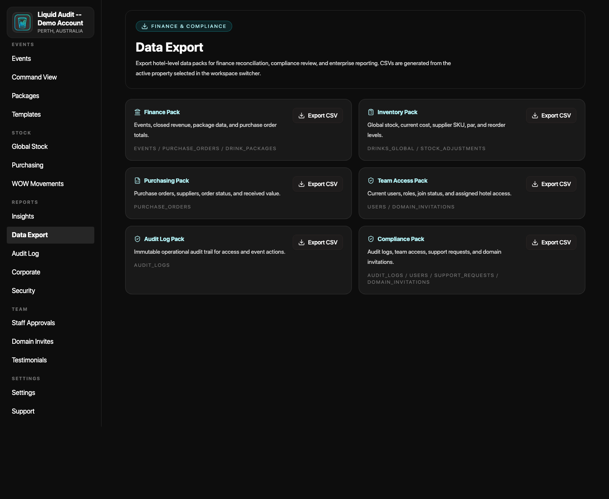
LIQUID AUDIT FINANCE BRIEFING
Finance gets a faster close, not another admin job.
The app helps managers capture event activity while it happens, then gives finance a repeatable export and audit path instead of a post-event chase.
2-4 hrs
A$27 hrs
1-3%
planning saving per event
Starter break-even
variance/waste target
Setup reuse, cleaner closeout, and fewer finance follow-ups.
A$1,188 per year equals about 27 saved hours at A$45/hr.
A modest control gain can protect real stock and beverage value.
Use this deck as a finance model. Replace event count, wage rate, and beverage value with your hotel's real numbers.
Finance export surface
The core value: managers move faster on event days, finance receives cleaner evidence, and the hotel has fewer undocumented exceptions to explain later.
The Liquid Audit finance briefing | planning model, not audited savings
01

Slide 2
EVENTS EXPLAINED SIMPLY
An event is a temporary mini-business inside the hotel.
For a few hours, the hotel is moving stock, serving guests, taking orders, changing plans, and creating revenue. Finance only sees clean numbers if the activity is captured while it is still fresh.
Before service
During service
After service
Menu, packages, stations, staffing notes, stock allocations, and par levels need to be ready before guests arrive.
Orders, transfers, urgent stock, wastage, station pressure, and manager decisions happen quickly.
Leftovers, usage, revenue, variance, sign-off, PDFs, CSV exports, and audit evidence need to be reconciled.
Why speed matters: if the team waits until tomorrow, the event becomes memory, screenshots, messages, and manual reconstruction.
The Liquid Audit finance briefing | planning model, not audited savings
02

Slide 3
WHERE THE COST HIDES
The expensive part is not one missing spreadsheet. It is the chase.
When event evidence is split across people and files, finance pays through delayed close, manager rework, unexplained variance, and weak accountability.
Current pattern
Controlled pattern
Managers remember details after service.
Setup, stock, stations, and menus sit in one workspace.
Finance asks for context days later.
Live issues are visible before close.
Stock movement and waste need manual explanation.
same event,
better process
Event Summary becomes the review surface.
Exports are gathered differently each time.
Finance exports and audit evidence are repeatable.
Finance value: fewer undocumented exceptions, fewer follow-up messages, and faster confidence in the numbers.
The Liquid Audit finance briefing | planning model, not audited savings
03

Slide 4
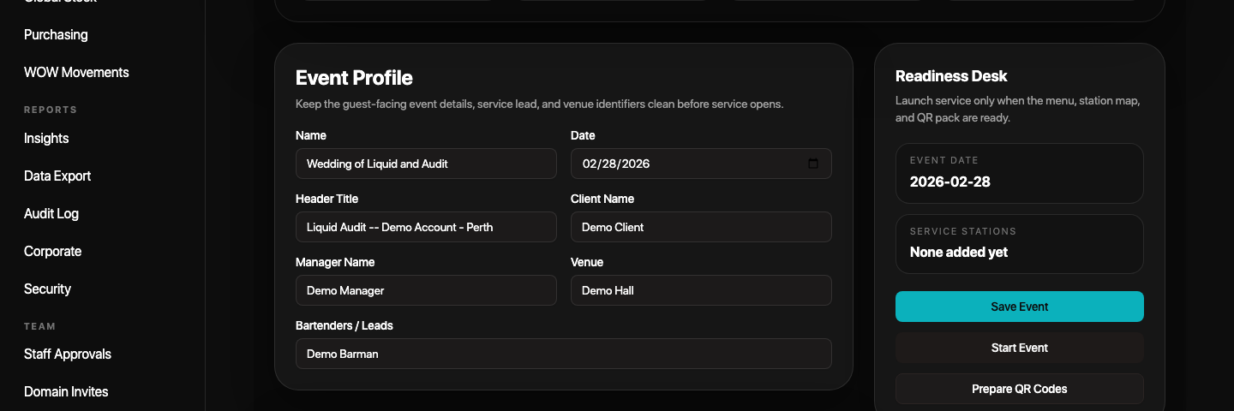
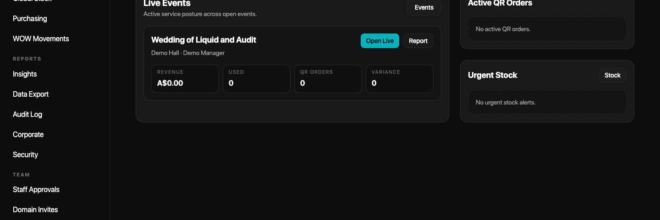
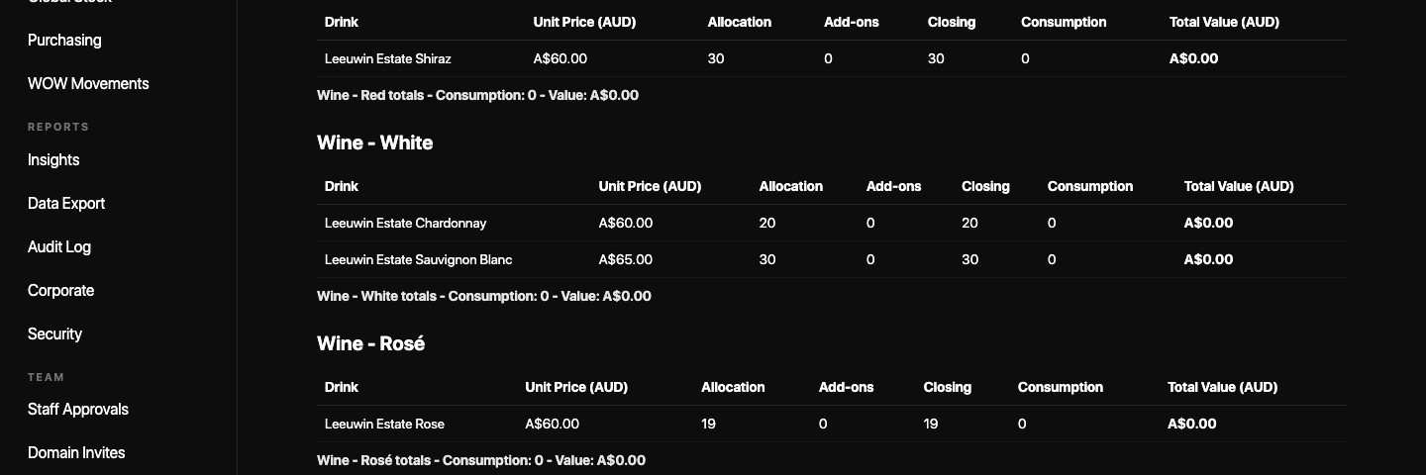
HOW THE APP HELPS
One workflow connects setup, service control, closeout, and finance exports.
Finance does not need every manager to invent a month-end pack. The app gives the team a standard path and standard evidence surfaces.
01
Set up
02
Run live
03
Close
04
Export
Event profile, packages, stock, stations, and template reuse.
Command View, QR order pressure, urgent stock, and variance risk.
Event Summary, close checklist, wastage, leftovers, and manager sign-off.
Finance, inventory, purchasing, audit, and compliance files.
Event setup
Live command
Event summary
What changes: event information is captured in the operating flow instead of reconstructed only for finance later.
The Liquid Audit finance briefing | planning model, not audited savings
04

Slide 5
TIME SAVED MODEL
A conservative model: 2-4 saved hours per event.
The savings come from repeat setup, cleaner closeout, faster finance evidence, and fewer follow-up questions. Replace the event count and wage rate with hotel actuals.
0.5-1 hr
1-2 hrs
0.5-1 hr
2-4 hrs
setup reuse
closeout/reporting
finance chase
total model
Templates, packages, menus, stations, and par levels reduce repeated preparation.
Event Summary, PDFs, close checklist, and exports reduce reconstruction.
Standard exports and audit trails reduce back-and-forth after service.
Use 2 hours as the conservative case and 4 hours as the stronger case.
Events/week
Events/year
Hours saved @2h
Hours saved @4h
Labor value @A$45/h
2
104
208
416
A$9.4k-A$18.7k
5
260
520
1,040
A$23.4k-A$46.8k
10
520
1,040
2,080
A$46.8k-A$93.6k
Assumption: blended manager/admin wage A$45 per hour. This is a planning model, not a guaranteed result.
The Liquid Audit finance briefing | planning model, not audited savings
05

Slide 6
MONEY SAVED MODEL
Small control gains can pay for the app quickly.
Hotels do not need huge savings for the subscription to make sense. A few avoided mistakes, less wastage, and cleaner stock control can cover the annual cost.
Example control gain on event beverage value
Where money is protected
Annual event beverage value
1%
2%
3%
Wastage and leftovers are visible before they become forgotten cost.
A$150,000
A$1,500
A$3,000
A$4,500
Transfers, extra allocation, stock usage, and movement history are easier to defend.
A$300,000
A$3,000
A$6,000
A$9,000
Purchasing and reorder queues reduce last-minute buying noise.
A$500,000
A$5,000
A$10,000
A$15,000
Package profitability and price changes become easier to review.
Finance takeaway: even a 1% improvement can be meaningful when the hotel runs enough event beverage volume.
The Liquid Audit finance briefing | planning model, not audited savings
06

Slide 7
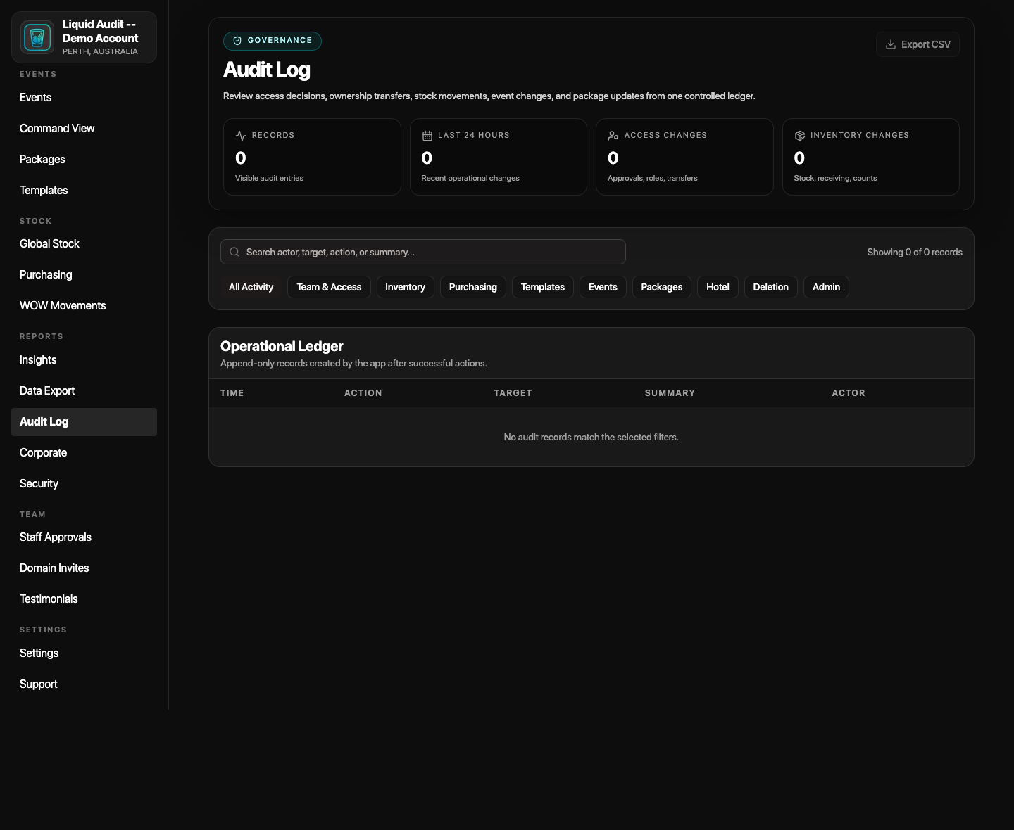
WHAT FINANCE RECEIVES
The process ends in a repeatable pack, not a collection of messages.
Finance can align with managers on the same export surfaces every month: revenue, event records, stock, purchasing, access, audit, and compliance.
Standard finance pack
Event summaries and closed revenue
Inventory, movement, and stock value
Purchase orders and received value
Team access and approval evidence
Audit log and compliance exports
Data Export: finance, inventory, purchasing, access, audit, compliance
Audit Log
Result: finance reviews a known packet and can trace numbers back to the live operating workflow.
The Liquid Audit finance briefing | planning model, not audited savings
07

Slide 8
VALUE FOR MONEY
The subscription only needs a small amount of saved time to pay back.
At a blended A$45/hour manager/admin cost, the annual plans break even at roughly one hour per week or less.
Plan
Annual price
Weekly cost
Hours to break even
Events to break even @2h saved
Starter
A$1,188
A$22.85
26.4 hrs/year
14 events/year
Growth
A$2,388
A$45.92
53.1 hrs/year
27 events/year
Enterprise
Custom
Estate based
Set by rollout scope
Use portfolio event count
A$3.25/day
A$6.54/day
30 days
Starter daily equivalent
Growth daily equivalent
pilot review window
A modest daily cost for a controlled event close process.
For heavier operations needing faster support and scale.
Run actual event count, hours saved, and avoided exceptions.
A few cleaner events, one avoided stock loss, or one hour per week can justify the spend.
The Liquid Audit finance briefing | planning model, not audited savings
08

Slide 9
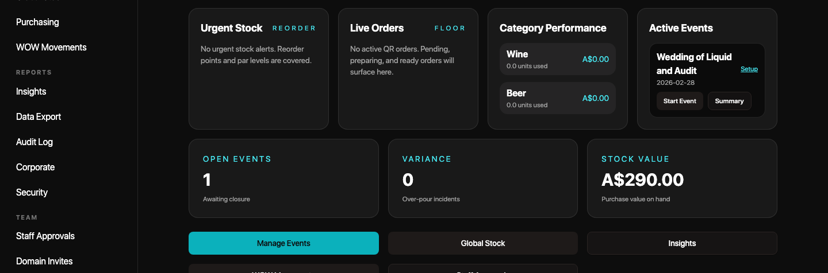
WHY MANAGERS CAN MOVE FASTER
The app fits the pace of event days.
Managers do not have time to rebuild a report while service is moving. The useful workflow is quick setup, live exception visibility, close checklist, then export.
01
Reuse setup
02
Watch pressure
03
Close event
04
Export
Templates and packages reduce repeated setup work.
Command View shows orders, urgent stock, revenue pace, and variance.
Summary, leftovers, wastage, open orders, and sign-off stay together.
Finance gets a standard pack.
Manager Snapshot
Command View
Event Summary
Manager value: less memory work after service, fewer manual screenshots, and a clearer sign-off path before finance starts reviewing.
The Liquid Audit finance briefing | planning model, not audited savings
09

Slide 10
DECISION CLOSE
Approve the process, then measure the savings.
The finance decision does not need to be abstract. Run one demo event, agree the export pack, assign sign-off ownership, and review actual time saved after 30 days.
Finance approval checklist
Manager script
Agree the standard finance export packet.
We can show where the event is set up, how service is controlled, how closeout is reviewed, and where finance exports and audit evidence come from.
Confirm who owns event close sign-off.
Confirm audit/security evidence needed monthly.
Website: omnari.world/the-liquid-audit
Use actual event count and wage rate in the model.
Next step: run a guided demo event and compare actual admin time against the model.
The Liquid Audit finance briefing | planning model, not audited savings
10

