Slide 1
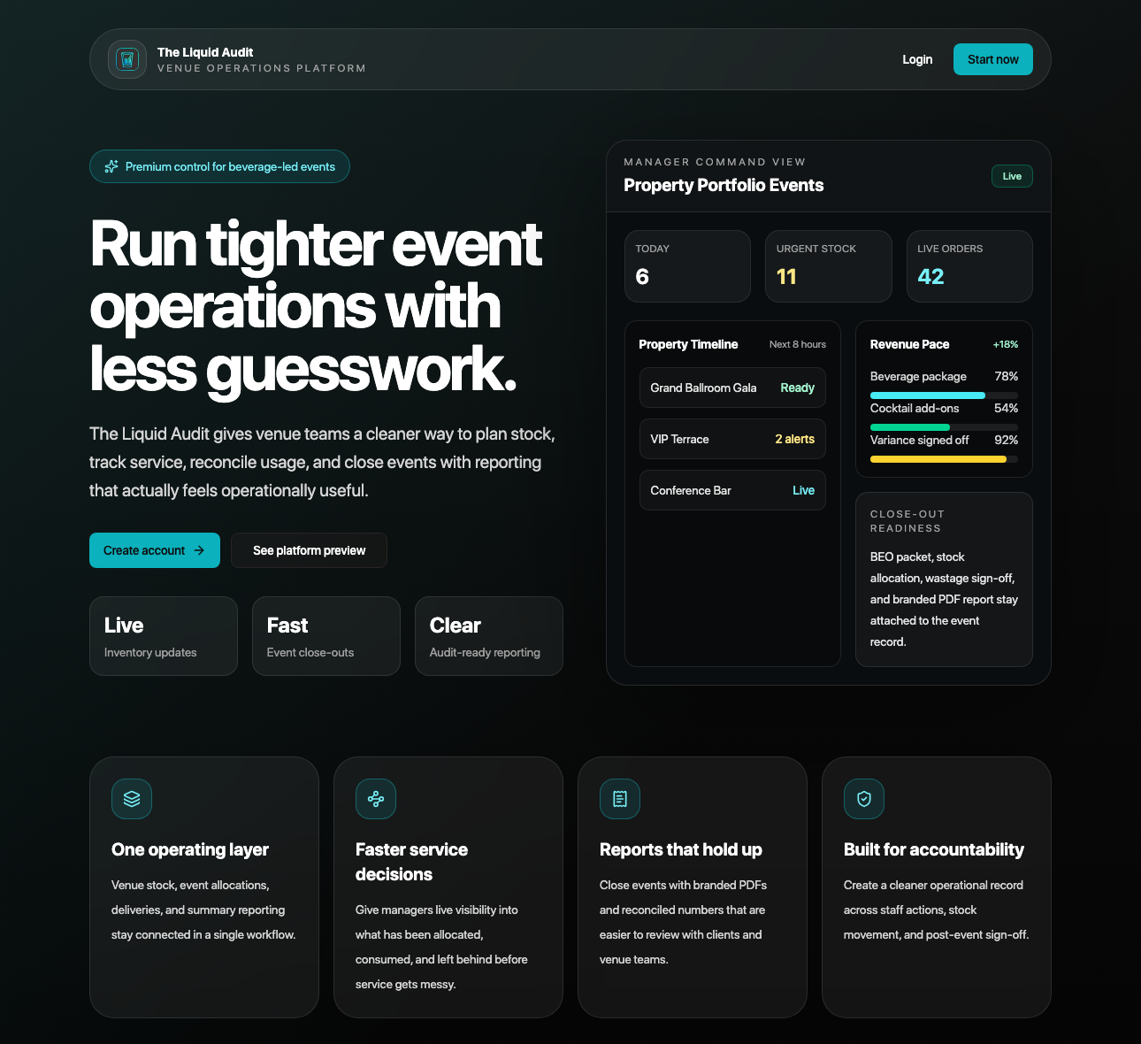
NO EVENT KNOWLEDGE NEEDED
The Liquid Audit makes hotel events easier to control.
Current product homepage
A hotel event is a short, high-pressure service window. The app gives managers one place to prepare it, run it, close it, and hand evidence to finance.
Less confusion
Cleaner numbers
Better proof
Roles, stations, menus, and staff access are controlled before service starts.
Stock, orders, movement, revenue, and exports stay tied to the event record.
Audit, close-out, and finance packs reduce the need to rebuild evidence later.
The Liquid Audit | Hotel value walkthrough
01

Slide 2
PLAIN ENGLISH EVENT MAP
An event is a temporary mini-business inside the hotel.
Even a simple function creates a moving chain: planned drinks, staff, stations, guest orders, stock usage, payments, wastage, and finance review.
Before service
During service
After service
Create the event, choose menus, assign stations, set par levels, approve staff access, and prepare the operating baseline.
Watch QR orders, station status, drink usage, transfers, live stock pressure, variance risk, and revenue pace.
Close the event, review wastage, export finance evidence, preserve audit history, and update stock movement records.
The Liquid Audit | Hotel value walkthrough
02

Slide 3
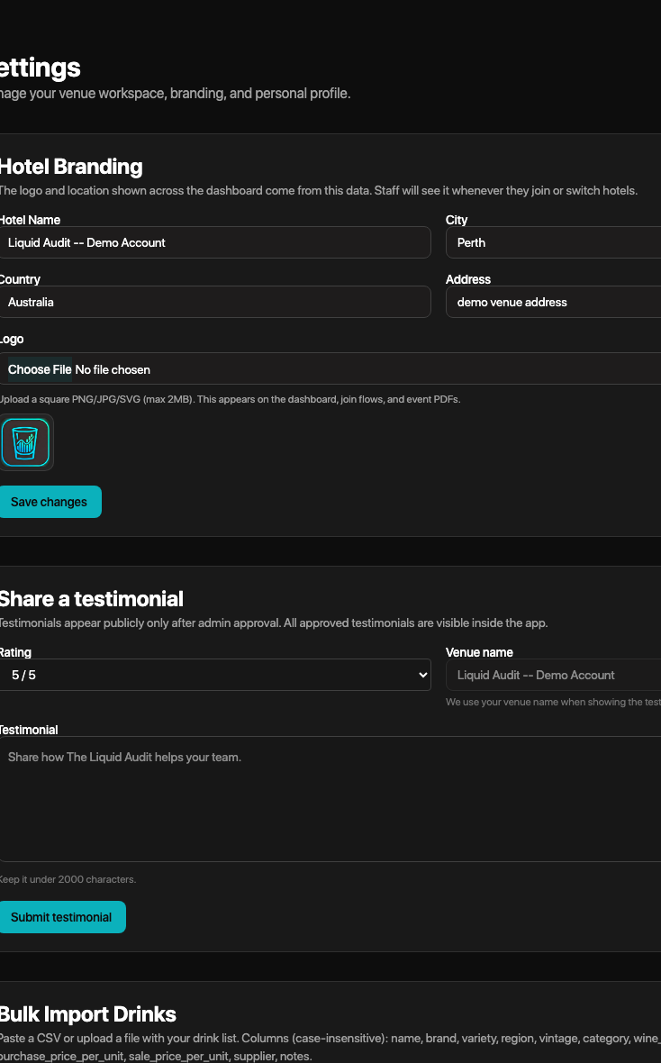
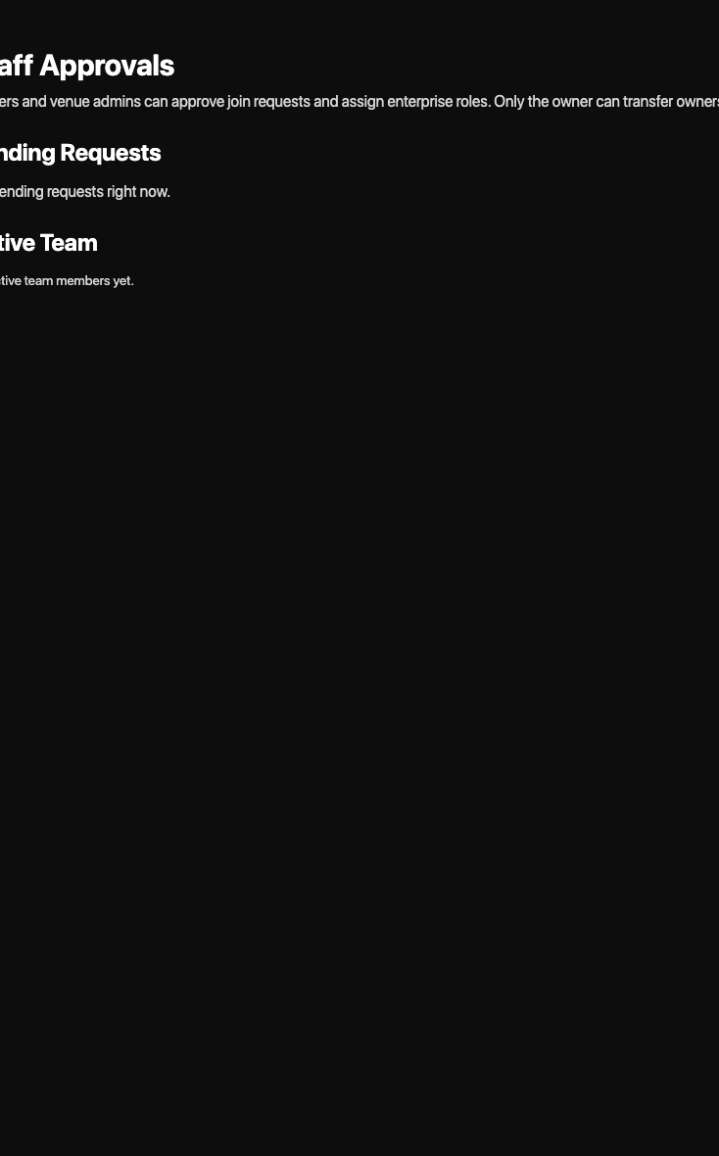
HOTEL OPERATIONS
The workspace controls who can act.
Venue settings
Staff approvals
Hotels need control before speed. The app supports property setup, branding, roles, staff approval, domain invitations, and enterprise login options.
Property control
Access control
Hotel profile, branding, departments, property code, region, and corporate group.
Owner, admin, manager, supervisor, stock, finance, and auditor roles with approvals.
Enterprise-ready login
Google Workspace and configurable SAML SSO can support hotel identity standards.
The Liquid Audit | Hotel value walkthrough
03

Slide 4
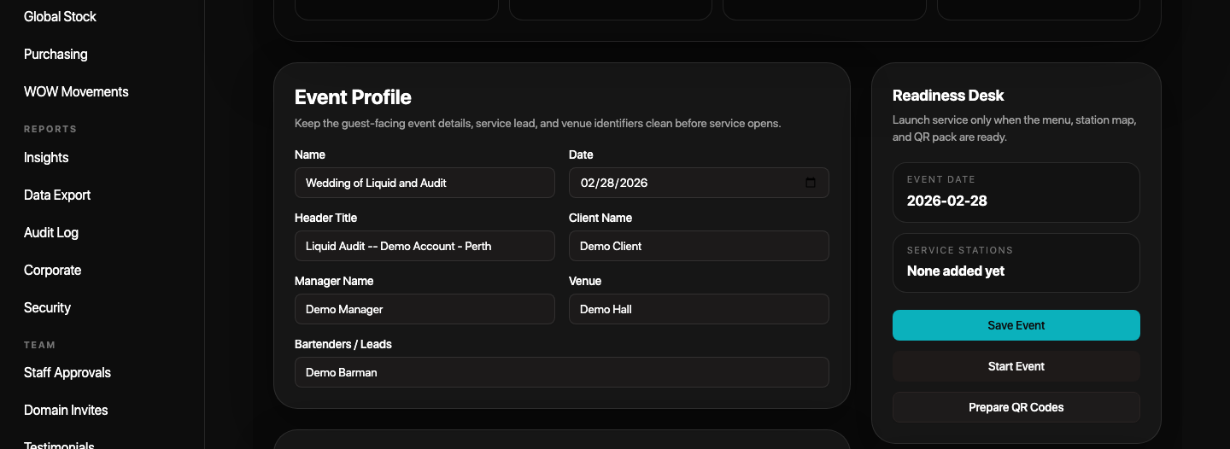
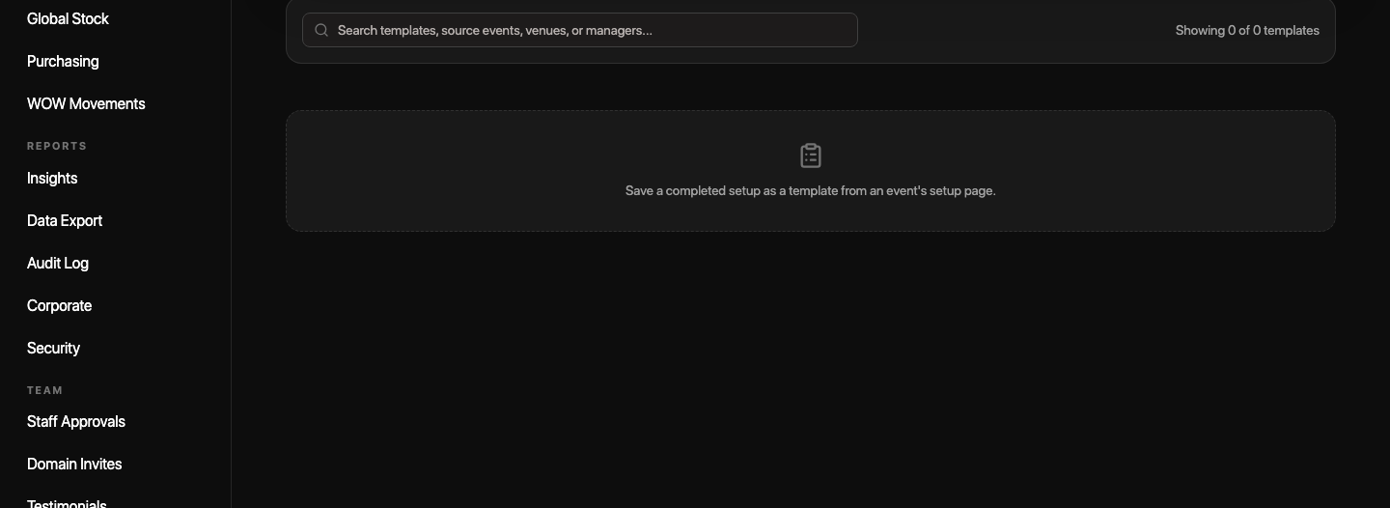
EVENT SETUP
Setup turns a booking into a ready service plan.
The setup path translates the event booking into menus, packages, stations, par levels, staffing notes, templates, and BEO-style packets.
1. Event details
2. Menu and packages
3. Stations and par
4. Packet and go-live
Event setup
Event templates
The Liquid Audit | Hotel value walkthrough
04

Slide 5
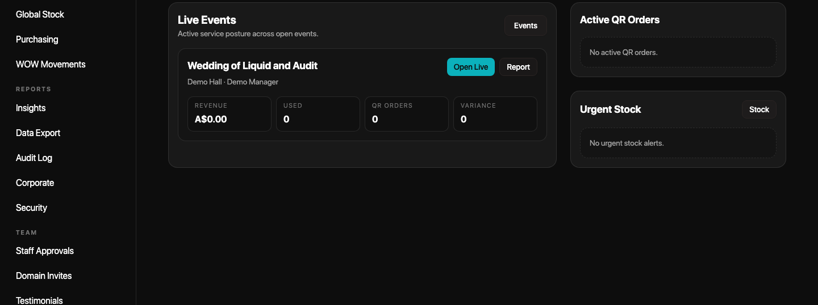
LIVE EVENT MANAGEMENT
Live service needs one view of orders, stations, stock, and revenue.
QR and station pressure
Station-specific QR orders, order status, preparation flow, and delivery progress roll up to the event.
The command view helps a manager see what is happening while the event is still running, not only after it is too late to react.
Stock and variance signals
Live operations command
Live usage, transfers, leftovers, extra allocation, and urgent stock risks stay visible.
Event-floor resilience
Offline usage queue support keeps stock updates moving during unstable internet.
The Liquid Audit | Hotel value walkthrough
05

Slide 6
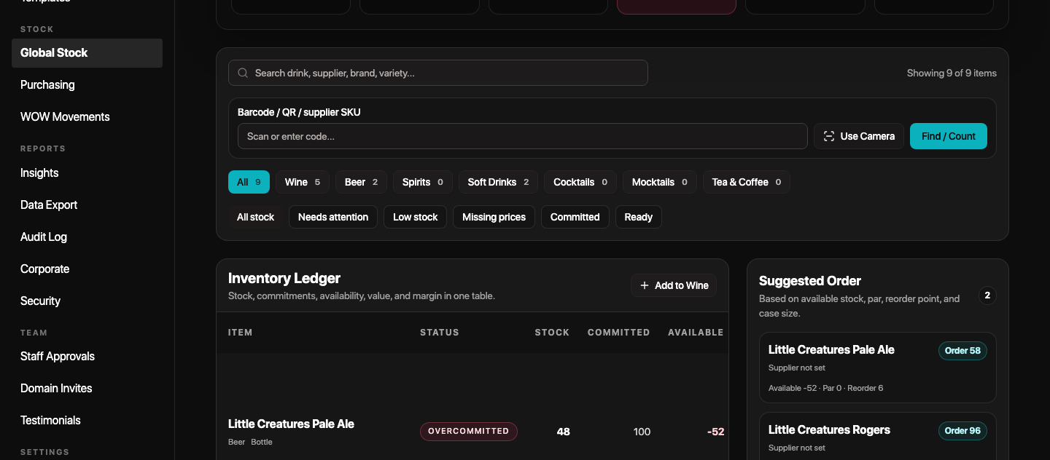
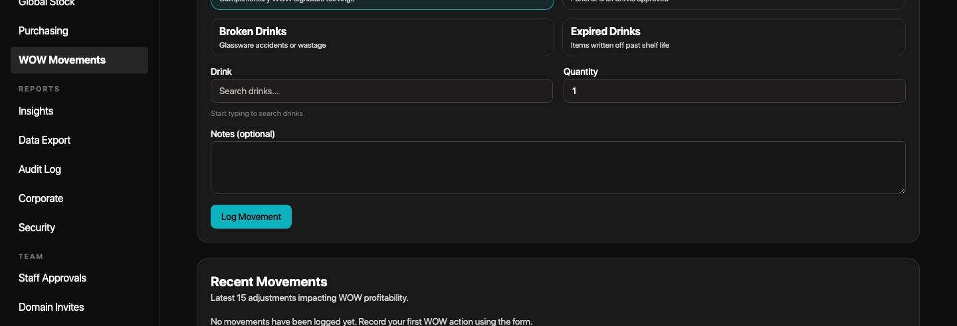
INVENTORY
Inventory becomes an accountable hotel ledger.
Global stock ledger
The app treats stock as a living record: product details, suppliers, cost fields, stock counts, adjustments, movements, and usage all connect back to the hotel.
Product truth
Stock control
Categories, brands, wine details, suppliers, SKU, purchase price, sale price, and recipe/cocktail costing fields.
Par levels, reorder points, bulk import, duplicate cleanup, scan area, and stock count approval.
WOW movements
Movement history
Adjustments, transfers, WOW movements, write-offs, usage, leftovers, and received orders can preserve the operational trail.
The Liquid Audit | Hotel value walkthrough
06

Slide 7
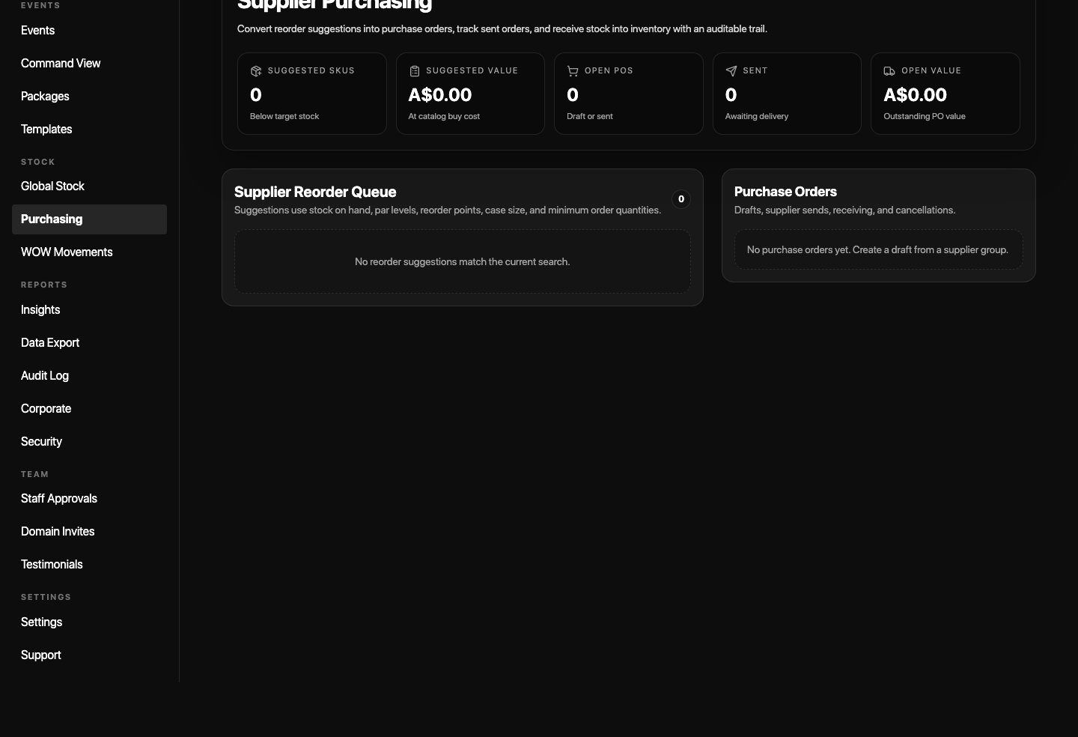
PURCHASING
Purchasing turns low stock into a trackable order.
Purchasing workflow
Supplier reorder queues and purchase orders help teams turn stock risk into action, then connect received orders back into stock movement records.
Low stock or par gap
Draft purchase order
Supplier + SKU + cost
Received stock update
Supported PO states: draft, sent, received, cancelled.
The Liquid Audit | Hotel value walkthrough
07

Slide 8
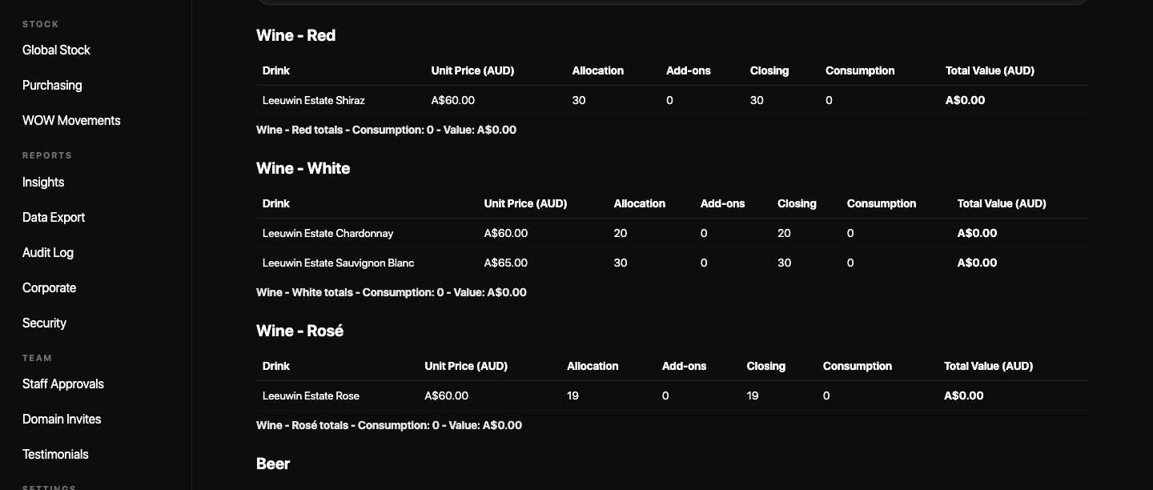
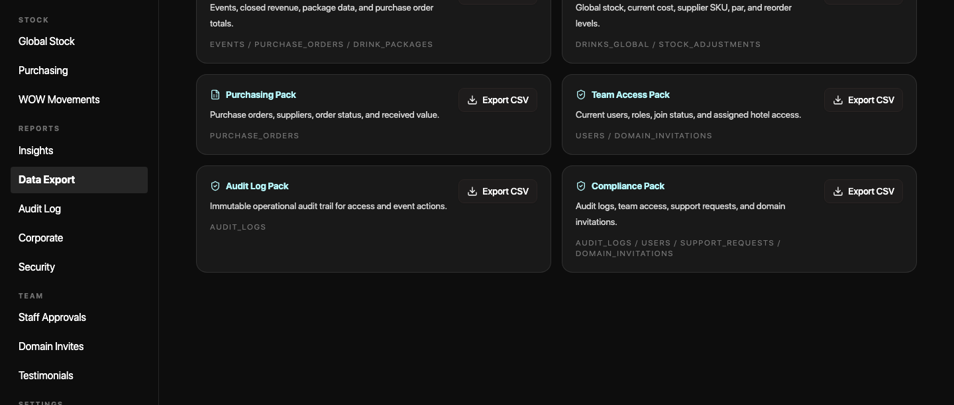
ANALYTICS AND REPORTS
Close-out converts service activity into finance evidence.
After service, the goal is not more admin. It is a clean package of event summary, station revenue, consumption, variance, wastage, PDFs, and CSV exports.
Event summary
Data export
Event summary PDFs
BEO packet PDFs
Finance CSV exports
Tea & Coffee grouping
The Liquid Audit | Hotel value walkthrough
08

Slide 9
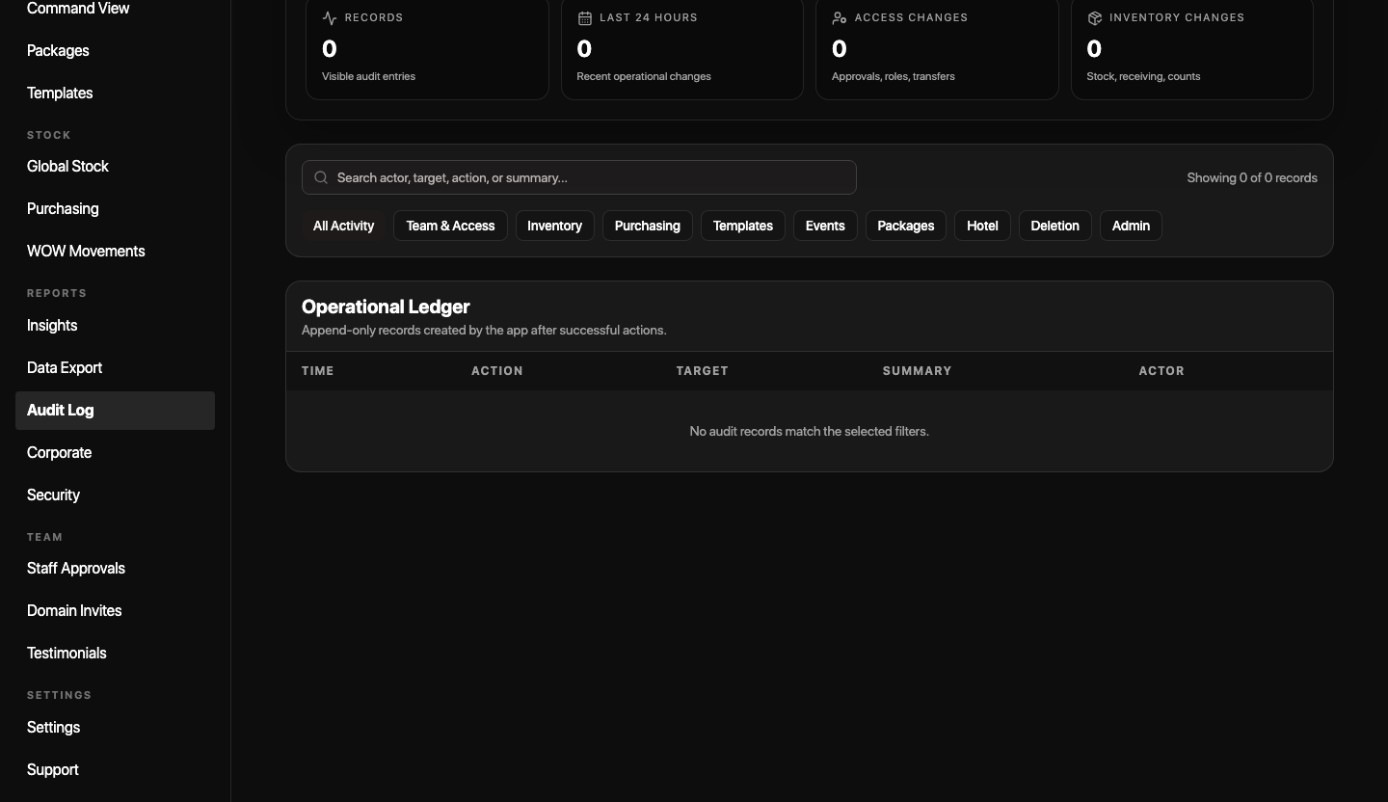
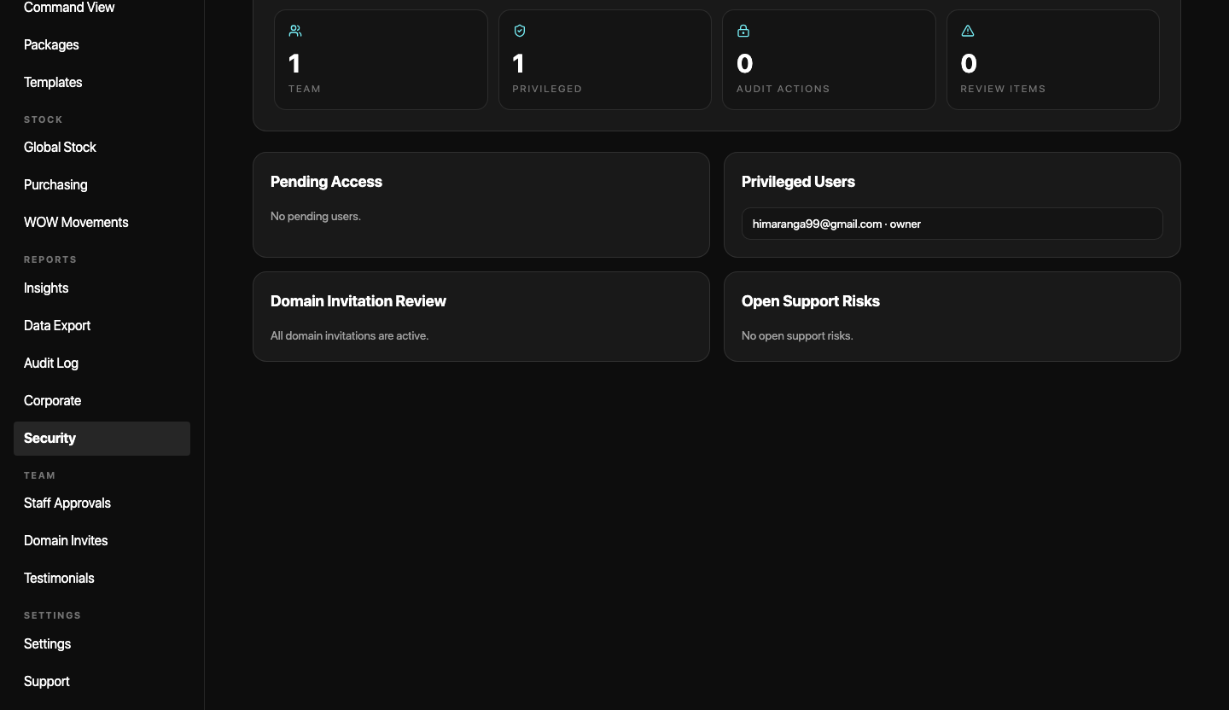
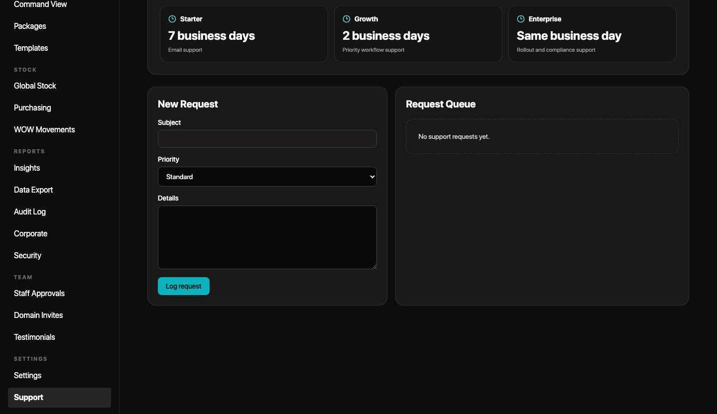
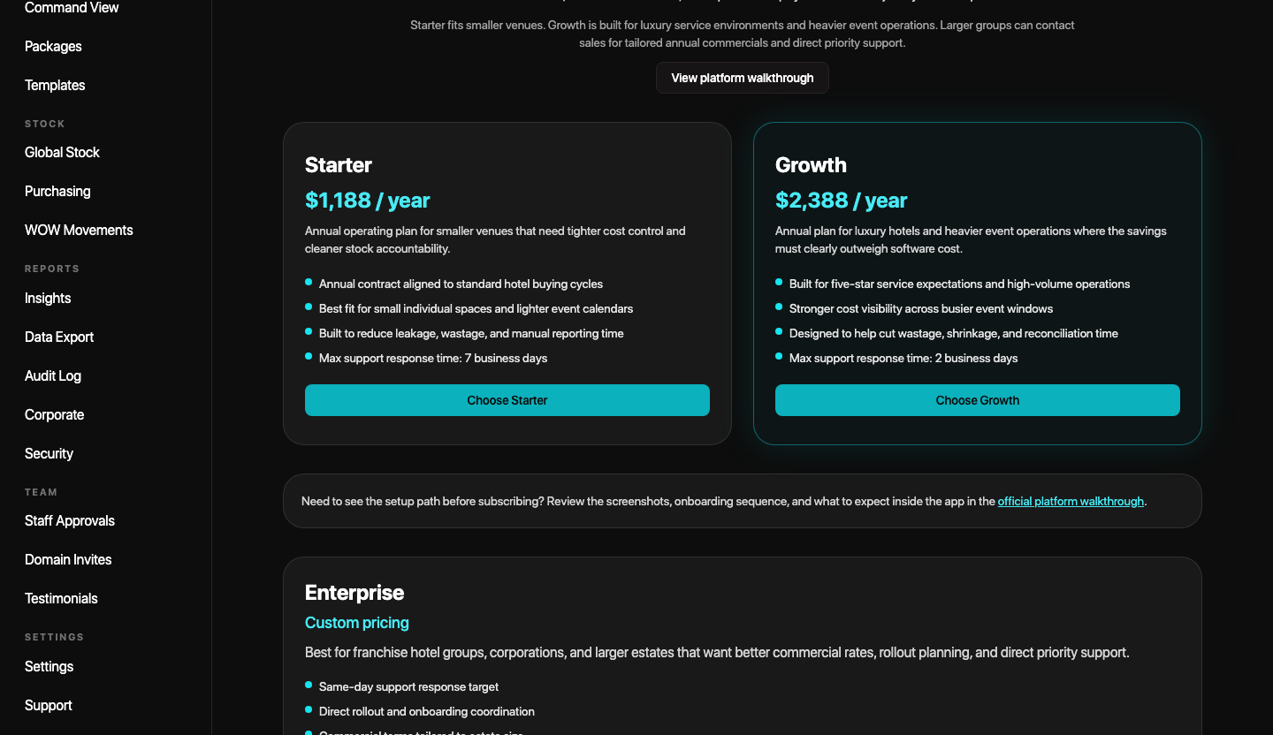
COMPLIANCE, ADMIN AND BILLING
Governance is built into the same operating path.
Enterprise controls
Stripe checkout, owner code activation, invoice workflows, billing status, and admin activation after payment.
Audit history, security posture, support/SLA tracking, deletion requests, and billing workflows matter because hotel teams need confidence after the event is over.
Audit log
Security report
Support panel
Billing
The Liquid Audit | Hotel value walkthrough
09

Slide 10
FEATURE COVERAGE MAP
The feature set covers the full hotel operating chain.
For a non-events viewer, the product is easiest to understand as five linked jobs: control the hotel, prepare service, run service, manage stock, and prove the result.
Capability group
What the hotel can do
Simple value
Hotel operations
Create properties, manage branding, roles, access, SSO, and approvals.
Controlled rollout
Event setup
Build menus, packages, templates, stations, par levels, staffing notes, and BEO packets.
Ready before service
Bars and QR orders
Run stations, QR/hybrid modes, order status, transfers, usage, and station close.
Live visibility
Inventory and purchasing
Track stock, suppliers, prices, counts, movements, PO queue, receiving, and costing.
Cleaner stock control
Reports and compliance
Export PDFs/CSVs, audit logs, security reports, support records, and billing evidence.
Finance-ready proof
The Liquid Audit | Hotel value walkthrough
10

Slide 11
ROLLOUT VIEW
Start simple, then expand without losing control.
A hotel does not need to understand every feature on day one. The safest rollout is to start with one property and one workflow, then widen usage as teams trust the operating evidence.
1. Owner/admin
2. Event manager
3. Service team
4. Finance
Create the property, configure branding, approve staff, and set billing or invoice path.
Build event templates, menus, stations, par levels, and BEO-style service packets.
Run stations, QR orders, stock allocation, transfers, live usage, and event close checklist.
Review summaries, exports, audit logs, purchasing, compliance, and billing evidence.
The value is not one feature. It is the connected chain from setup to service to finance proof.
The Liquid Audit | Hotel value walkthrough
11

